Slide 1
DTALite
Aditya Marathe
Arizona State University

Slide 2
Key points
Network conversion
GMNS network
osm2gmns
cube2gmns
General shapefiles
YML settings
Introduction
Data hierarchy
Master settings
ASU network using OpenStreetMap
Sioux Falls network
Standard Solution
Basic Settings
Measurement Units
Iteration Settings
Convergence Settings
Multi-period Analysis
Shapefile
Network Conversion
Node CSV file
Link CSV file
Demand CSV file
Physical network with demand
Configure YML settings
Master settings
Run DTALite
DTALite results

Slide 3
GMNS network
GMNS stands for ‘General Modeling Network Specification’
This format provides a common human and machine readable format for sharing routable road networks
The following are the methods to convert shapefiles to GMNS format
Method 1: osm2gmns allows the user to import the desired network using Open Streets Maps
Method 2: cube2gmns allows the user to convert the CUBE shapefile directly to GMNS format
Method 3: General shapefiles can be converted to GMNS format using GIS tools such as QGIS
OSM file
osm2gmns
Node CSV file
Link CSV file
CUBE Shapefile
cube2gmns
General Shapefile
GIS tools

Slide 4
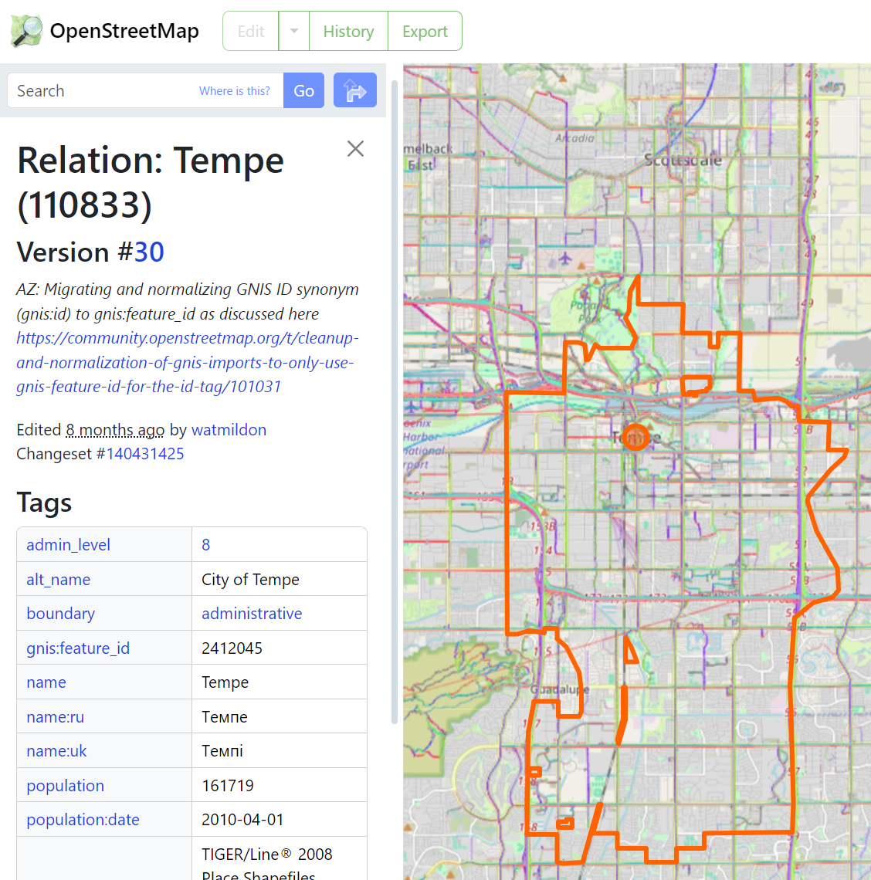
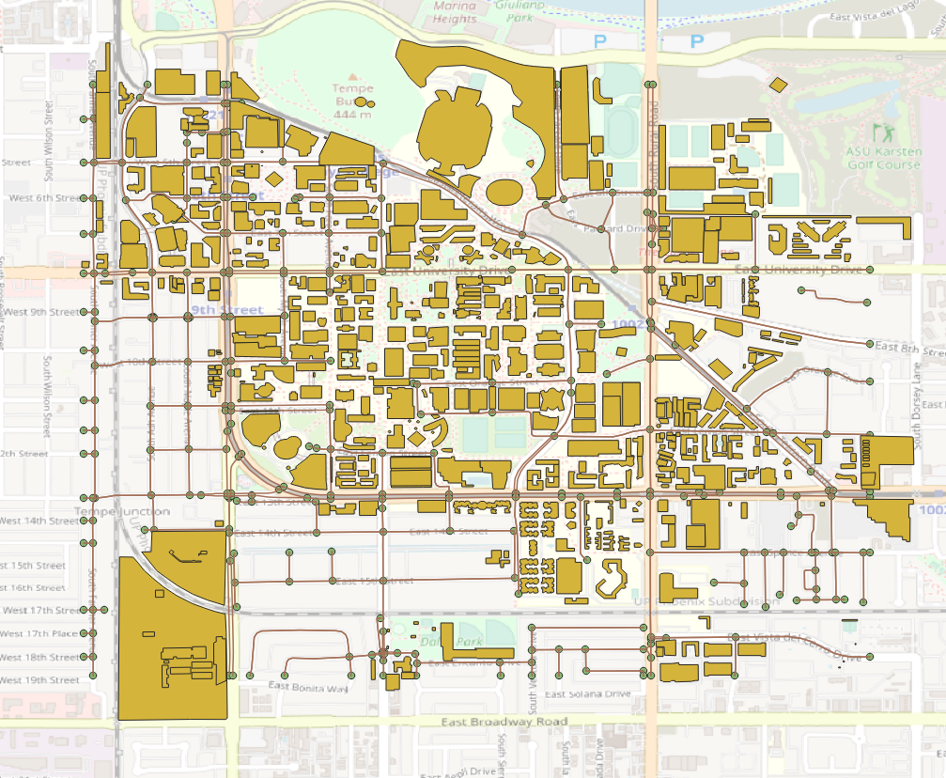
Method 1: osm2gmns
Python package: osm2gmns
Documentation: https://osm2gmns.readthedocs.io/en/latest/index.html
Features
Import and convert the desired network to GMNS format using OpenStreetMap
Contains tools and functions to convert the OSM file to GMNS format
Options to include mode types, default speed, default capacity, POIs and so on

Slide 5
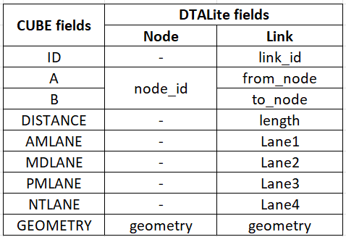
Method 2: cube2gmns
Dependency: pandas, geopandas, shapely, numpy
Python code that converts the CUBE shapefiles to GMNS format
Specifically built to be used in the MPO networks
Renames/converts/calculates the data and data headers from CUBE format to DTALite readable format
Splits the network shapefile into node and link files
The table shows some examples of the data headers

Slide 6
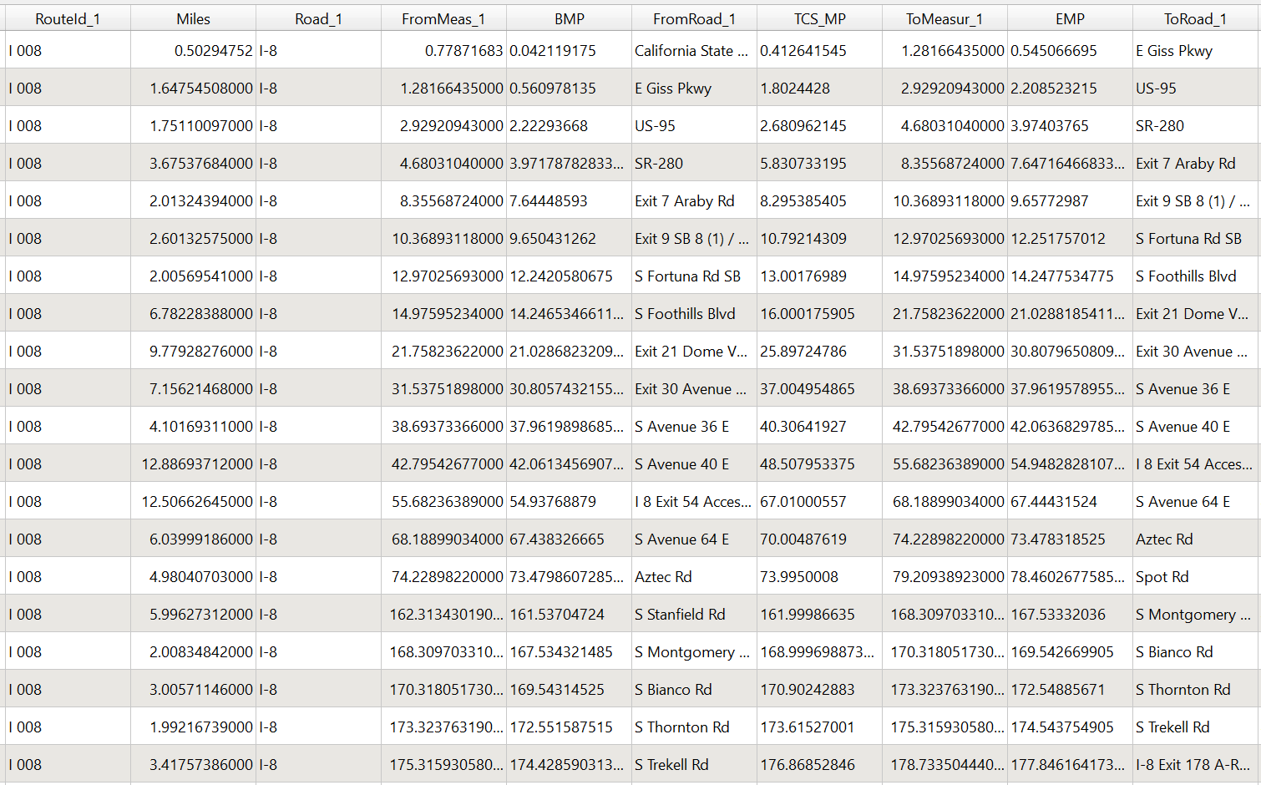
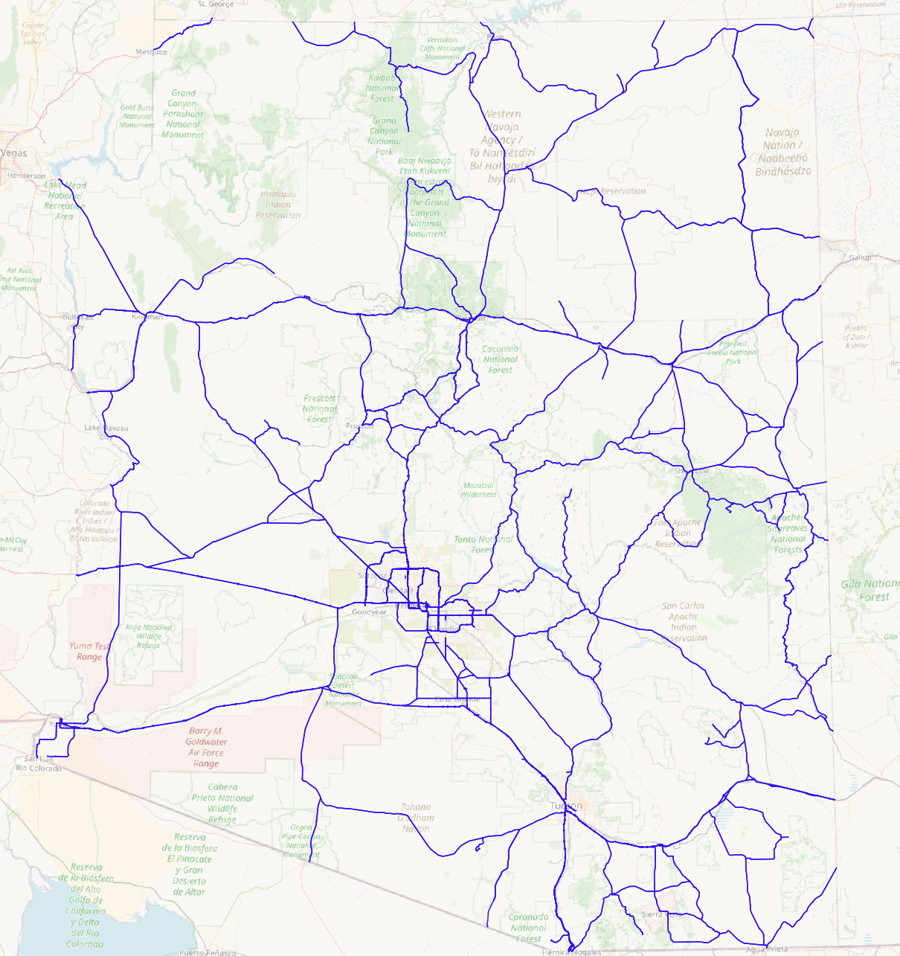
Method 3: General shapefiles
Shapefiles can be converted to CSV format using GIS tools such as QGIS
Methodology
Import shapefile as vector to GIS tool
Export shapefile as CSV from GIS tool
Split the converted network into node and link files, as per DTALite’s requirements
Rename/convert/calculate the data and data headers, as per DTALite’s requirements
The following images illustrate the interface of QGIS

Slide 7
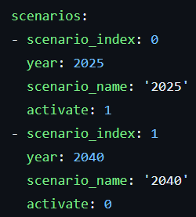
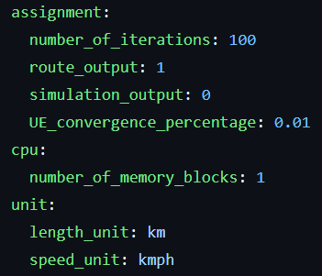
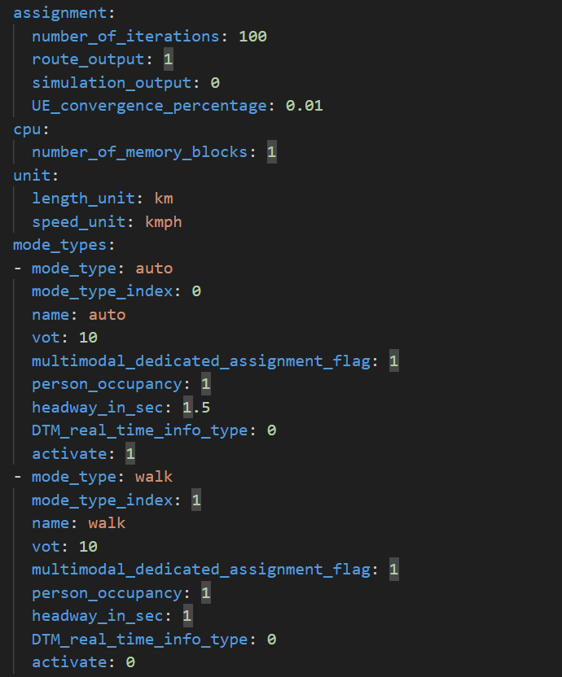
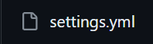
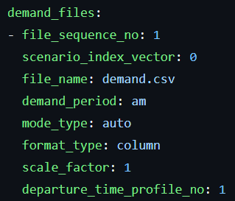
Introduction to YML settings
YAML is a human-readable data serialization language that is often used for writing configuration files
Features
Simplified configuration
Easy accessibility
Standardized validation
DTALite unifies all the configuration into a single settings file, which includes but not limited to…
Scenario list
Mode types
Demand files
Demand periods
Demand subarea

Slide 8
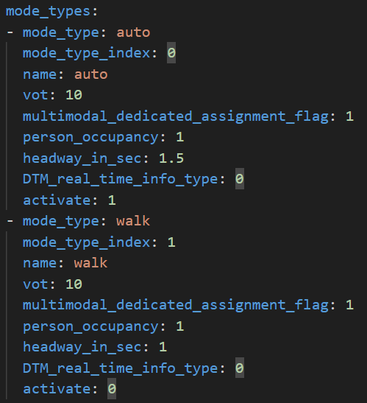
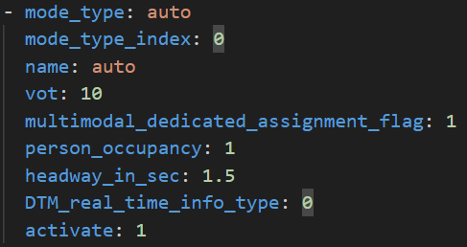
YML Data Hierarchy
Class
Class is defined as a dictionary
Class represents the different configuration files
They should never be modified or removed
For example, the mode types is considered as a class, and called as a string, i.e., [‘mode_types’] in python
Subclass
Subclass is defined as a list
They can be added, modified or removed
For example, the modes type: auto is considered as a subclass, and called as an index, i.e., [‘mode_types’][0] in python
Parameters
Parameters are defined as a dictionary
They can only be modified
For example, the activate: 1 is considered as a parameter, and called as a string, i.e., [‘mode_types’][0][‘activate’] in python

Slide 9
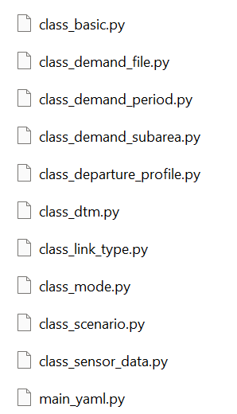
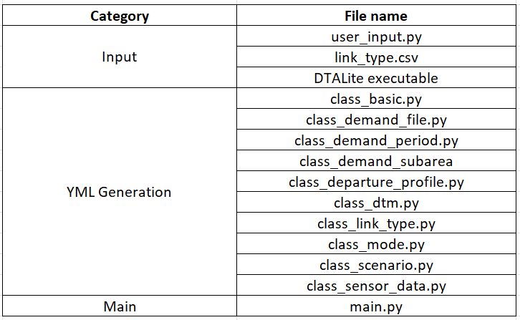
Master Settings
Dependency: ruamel.yaml python package
Features
Generate the YML settings
Run DTALite for multiple networks
Benefits
Standardized methodology
Easy customization
Reduces manual error
Components
Input
The user input allows the modification of basic class, demand class and the directory of the link type file
The link type CSV file can be provided by the user
Modifiable
Main
Running this file generates YML settings and runs DTALite for all network folders present in the specified directory

Slide 10
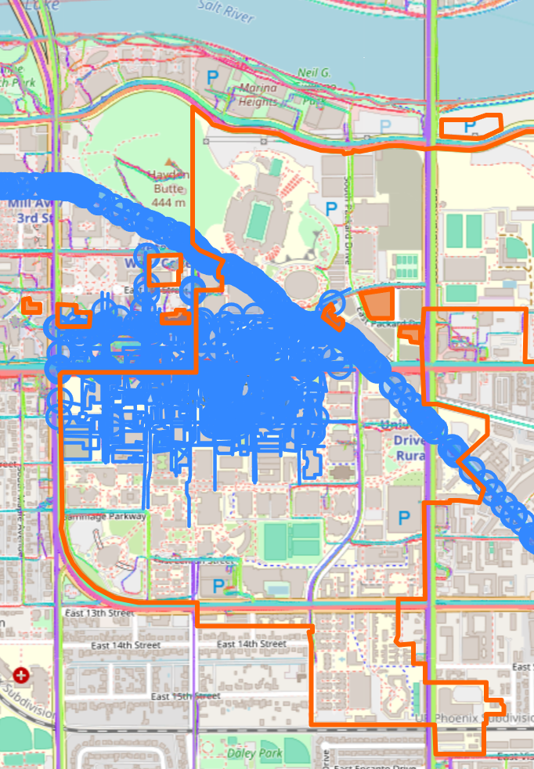
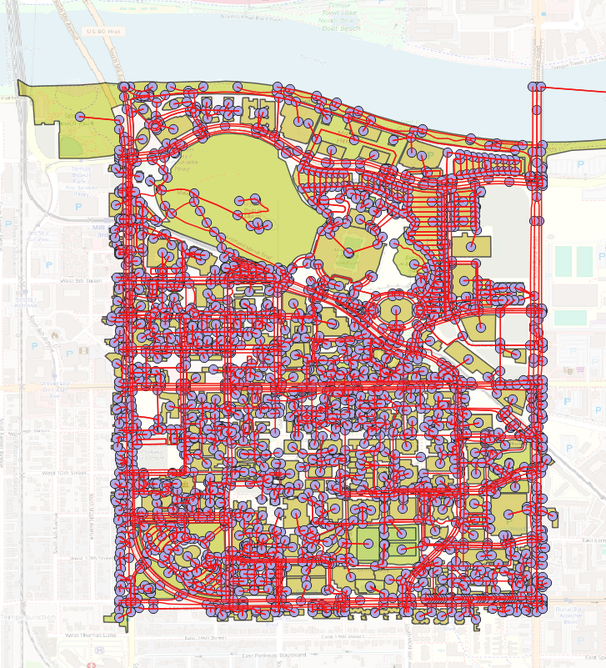
ASU network
Components
OpenStreetMap: Download the OSM file for selected area
OSM2GMNS: Generate routable network (node, link and POIs)
GRID2DEMAND: Generate the demand using POIs
Case Description
Network based on ASU campus
Generate routable network from scratch using of OpenStreetMap, OSM2GMNS, and GRID2DEMAND
Run DTALite for walk and bike modes only
Node CSV file
Link CSV file
Demand CSV file
OSM2GMNS
GRID2DEMAND
OpenStreetMap
QGIS visualization

Slide 11
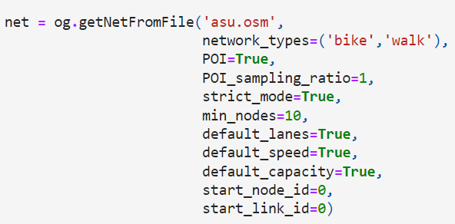
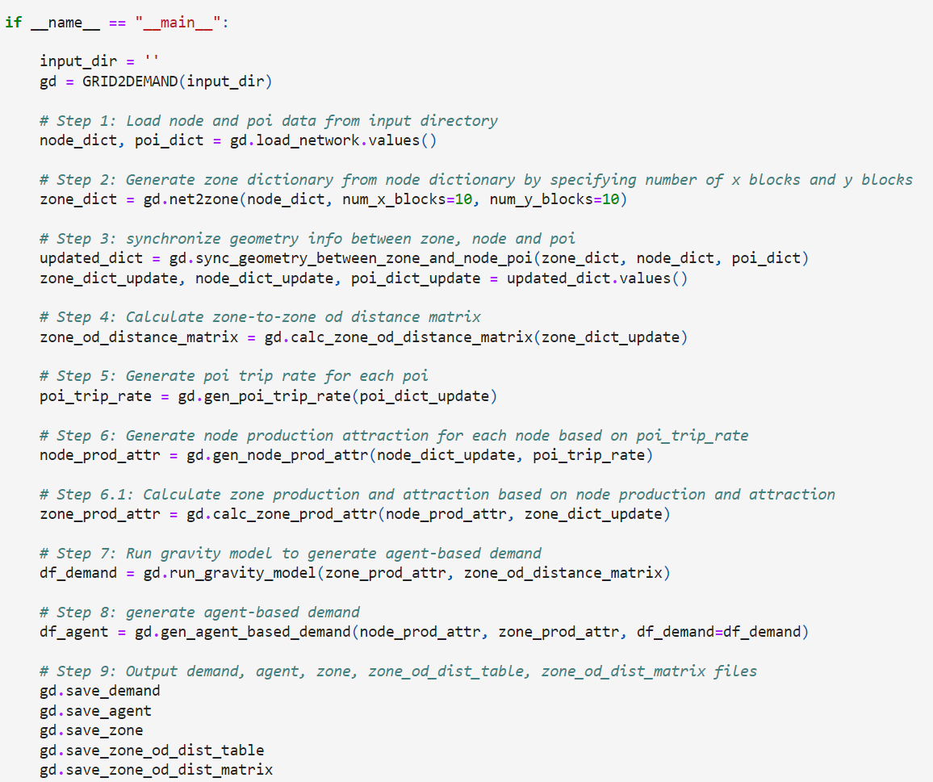
ASU network
Select the study area and export the OSM file from the OpenStreetMap website
Prepare the minimum input files
OSM file
YML settings file
DTALite executable
Convert the OSM network to GMNS network using OSM2GMNS
The mode types specified to bike and walk only
POI set to True, for demand generation
Minimum nodes eliminates isolated networks
Generate the demand file using GRID2DEMAND
Caution: Manually delete the first column ‘name’ from the poi.csv to prevent errors
Optionally, visualize the network on any GIS software, such as QGIS
Run the DTALite executable

Slide 12
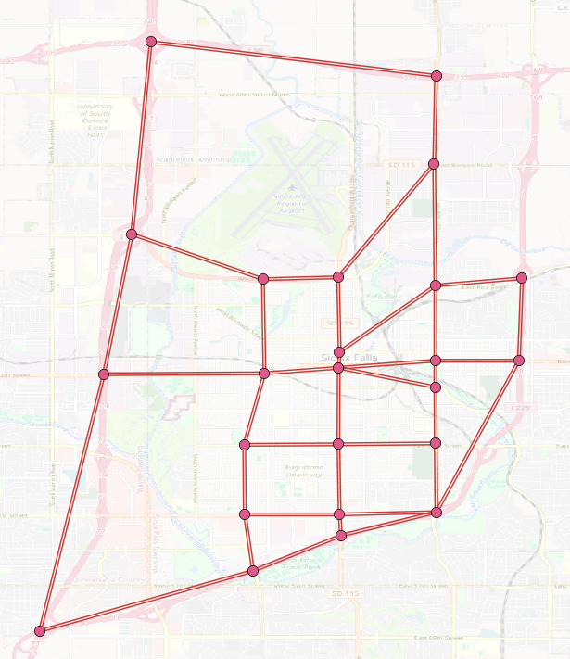
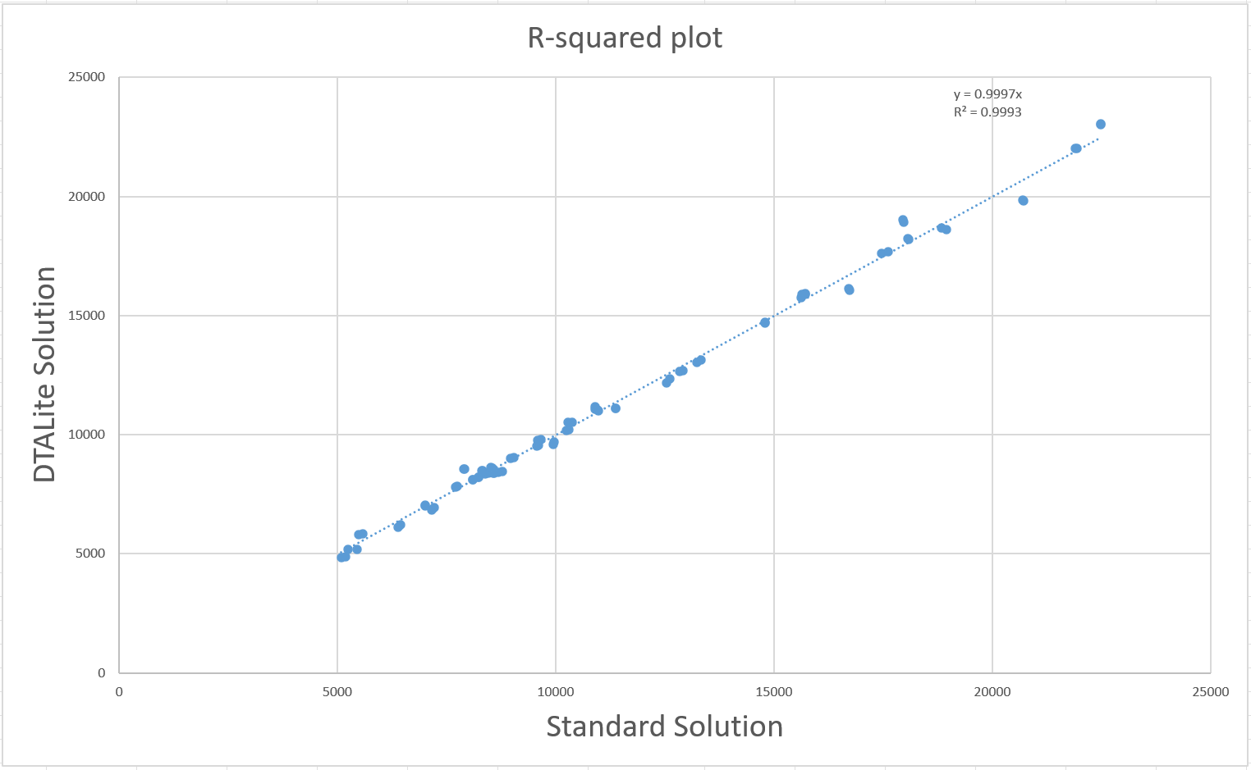
Sioux Falls network
Case 0: Standard Solution
This case demonstrates the accuracy of DTALite against the standard solution
Minimum input
Network files
YML settings
DTALite executable
Compare the vehicle volume against the standard volume by plotting a R-squared graph

Slide 13
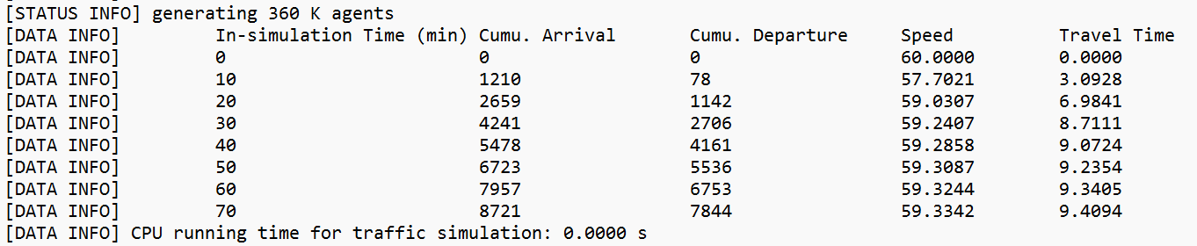
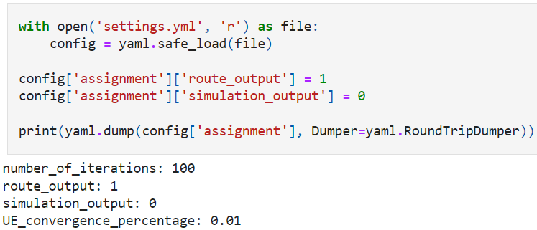
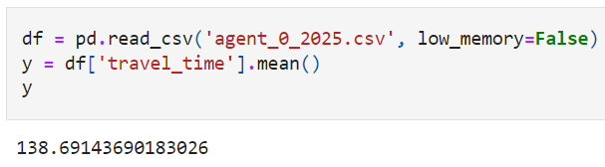
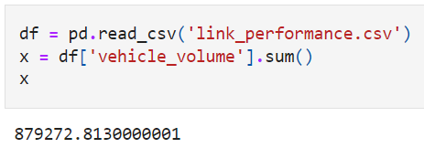
Sioux Falls network
Case 1: Basic Settings
This case provides a tutorial on enabling the route output and simulation output
Route output enables important results such as link performance, OD performance and system performance
Simulation output enables individual agents to be simulated, which provides individualized results for different parameters such as travel time, free speed, and so on
Minimum input
Network files
YML settings
DTALite executable

Slide 14
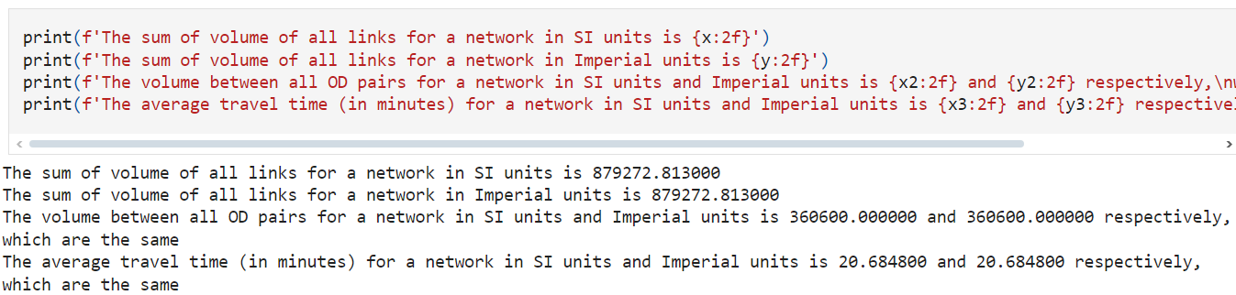
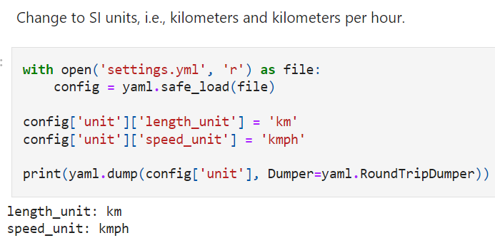
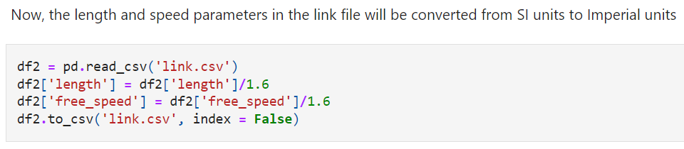
Sioux Falls network
Case 2: Measurement Units
This case proves that DTALite can use both SI units and Imperial units, by showing that sum of volumes for all the links are the same for both cases
However, it is important to provide the correct values in the link file
Minimum input
Network files
YML settings
DTALite executable

Slide 15
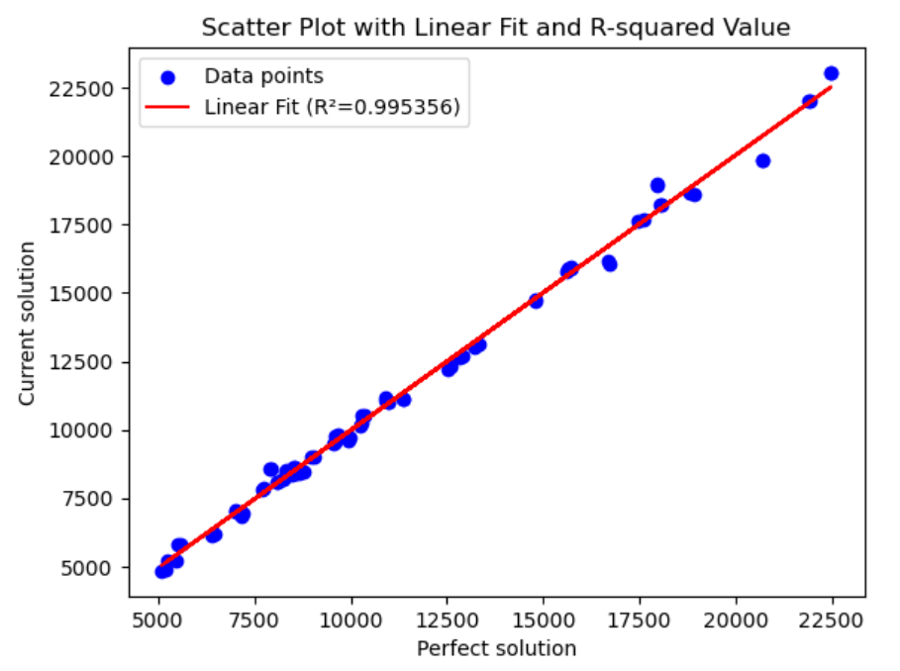
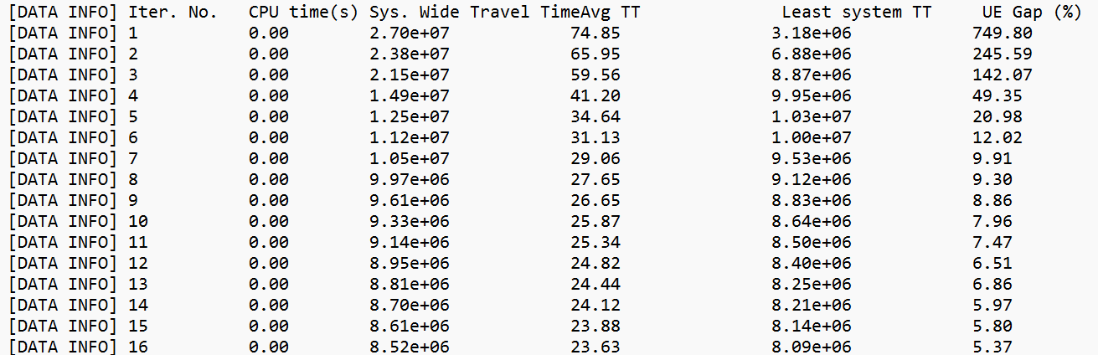
Sioux Falls network
Case 3: Iteration Settings
This case provides a tutorial on changing the number of iterations and demonstrates the difference in accuracy by comparing the results against the standard solution
The number of iteration controls the maximum number of times that DTALite is allowed to iteratively run the network to reach the target convergence gap
This directly influences the accuracy of the results, but higher numbers are time-intensive, especially in larger networks
Minimum input
Network files
YML settings
DTALite executable

Slide 16
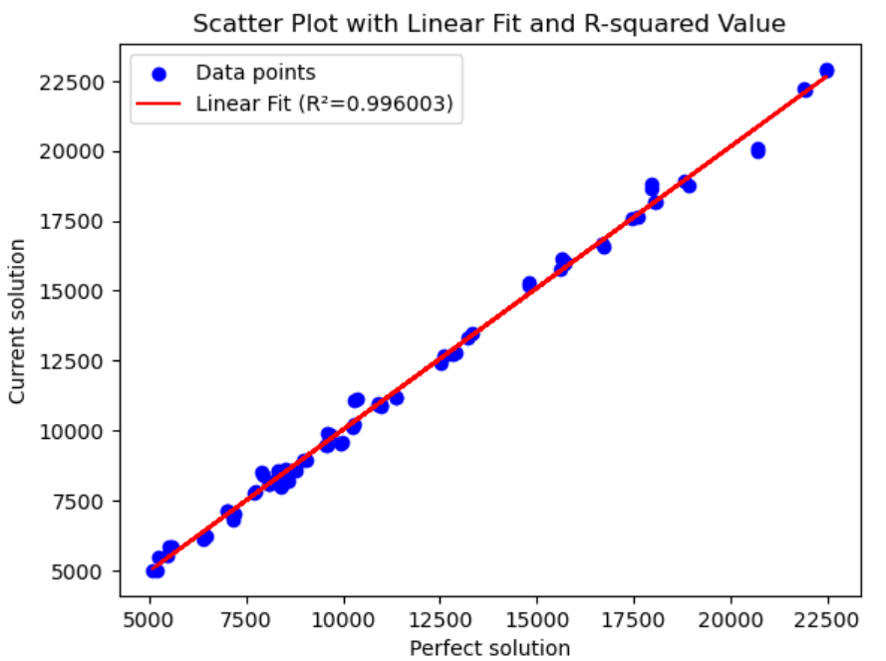
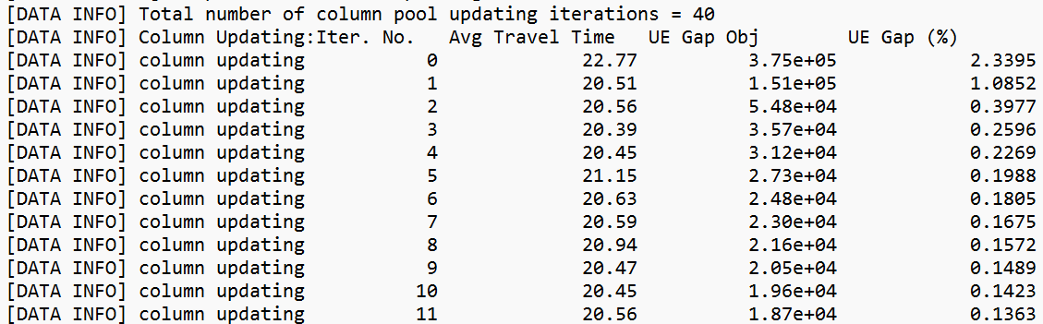
Sioux Falls network
Case 4: Convergence Settings
This case provides a tutorial on changing the target convergence and demonstrates the difference in accuracy by comparing the results against the standard solution
The target convergence gap is the convergence that DTALite tries to reach within the set number of iterations
This directly influences the accuracy of the results, but lower targets are time-intensive, especially in larger networks
Minimum input
Network files
YML settings
DTALite executable

Slide 17
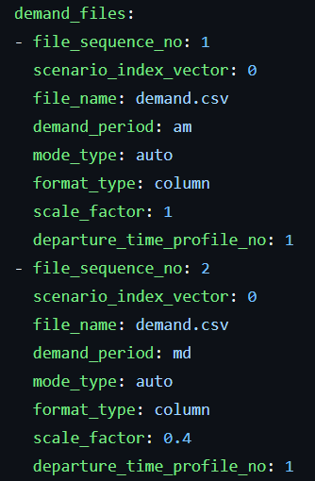
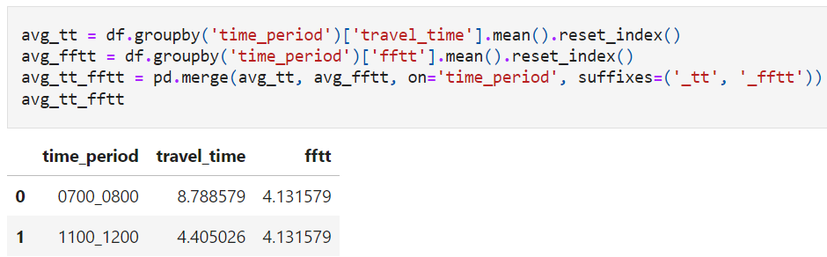
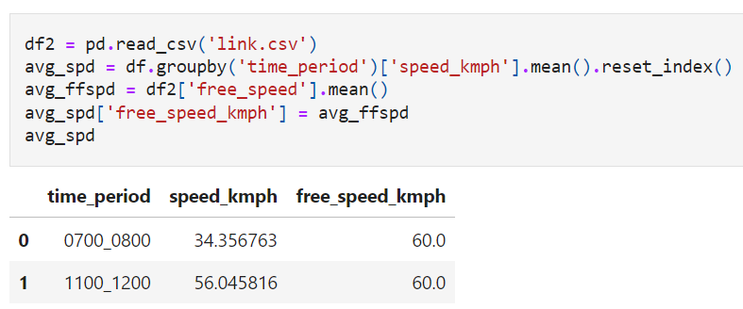
Sioux Falls network
Case 5: Multi-Period Analysis
This case provides a tutorial on adding a new demand period with a scale factor, and demonstrate the effect on travel time and free speed
Demand period allows different demand situations to be run on the same network without the hassle of separate networks or scenarios
Different demand files can also be used by specifying in the YML settings file
Minimum input
Network files
YML settings
DTALite executable

Slide 18
THANK YOU

